Slide 1

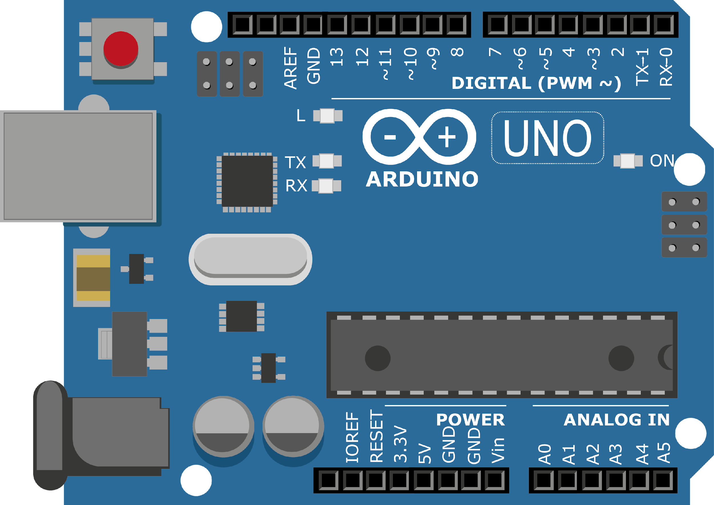
ARDUINO MASTER CLASS
21
Keypad with Arduino

Slide 2
21 AGENDA
02
03
01
Interface Keypad witch Arduino
Keypad
Interview questions &Tech News

Slide 3
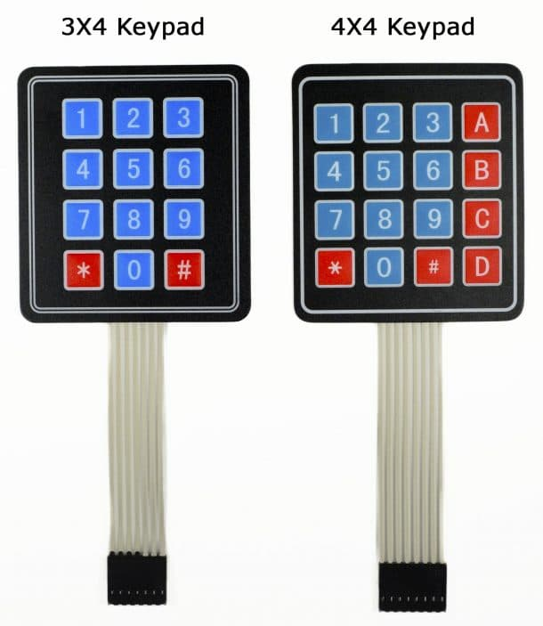
Keypad
Each switch in a row is connected to the other switches in the row by a conductive trace underneath the pad.
Each switch in a column is connected the same way – one side of the switch is connected to all of the other switches in that column by a conductive trace.
Each row and column is brought out to a single pin, for a total of 8 pins on a 4X4 keypad:

Slide 4
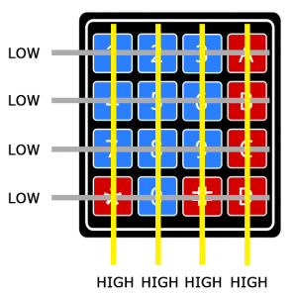
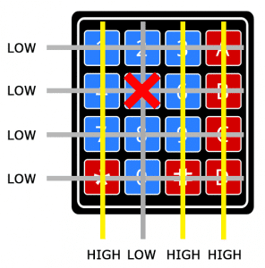
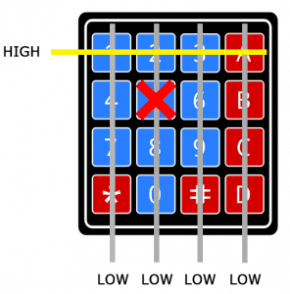
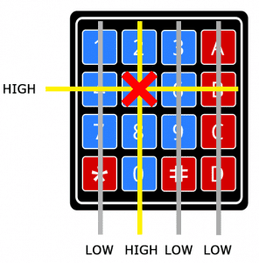
Keypad Working

Slide 5
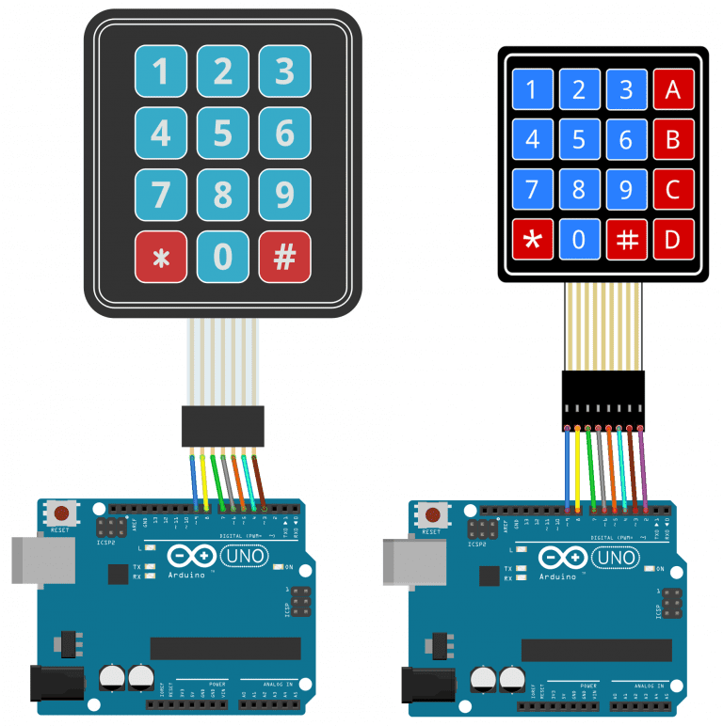
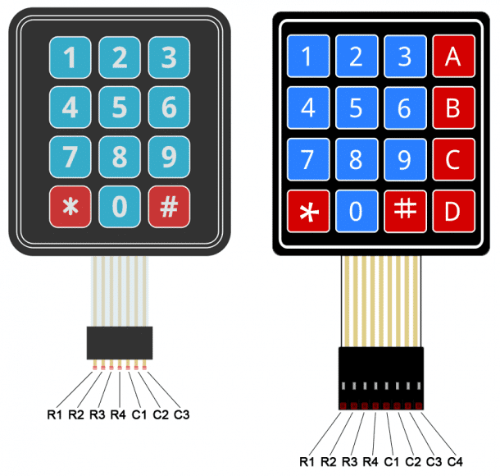
Keypad with Arduino

Slide 6
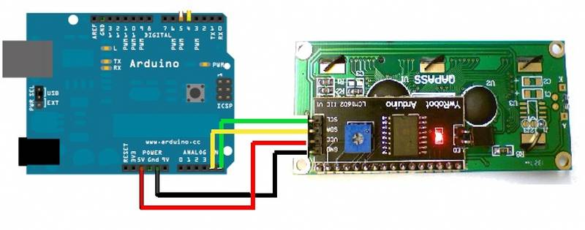
16x2 LCD with Arduino using I2C

Slide 7
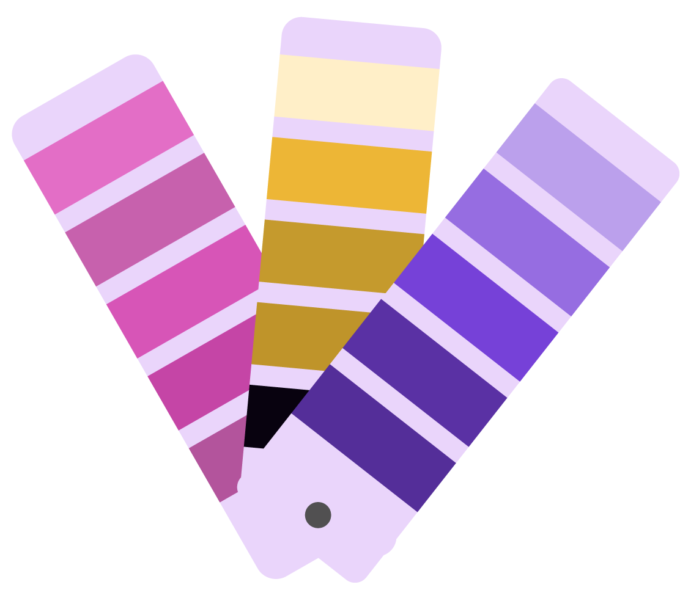
INTERVIEW QUESTIONS
Ripple Carry Adder and Carry Look Ahead Adder
What is a Filter
SCR
A Filter is an electronic circuit that removes specific or unwanted frequency components from a signal.
Low pass filter
Bandpass filter
Band stop or band reject filter
High pass filter
Notch filter
In ripple carry adder, the carry bits ripple through each individual adder while in a carry-look-ahead adder, the carry bit is determined separately using a CLA (Carry look ahead) block.
Silicon controlled rectifier is unidirectional semiconductor machine, but unlike diode, it has three terminals Anode, Cathode & Gate. The SCR can be switched on & off using the entrance input.

Slide 8
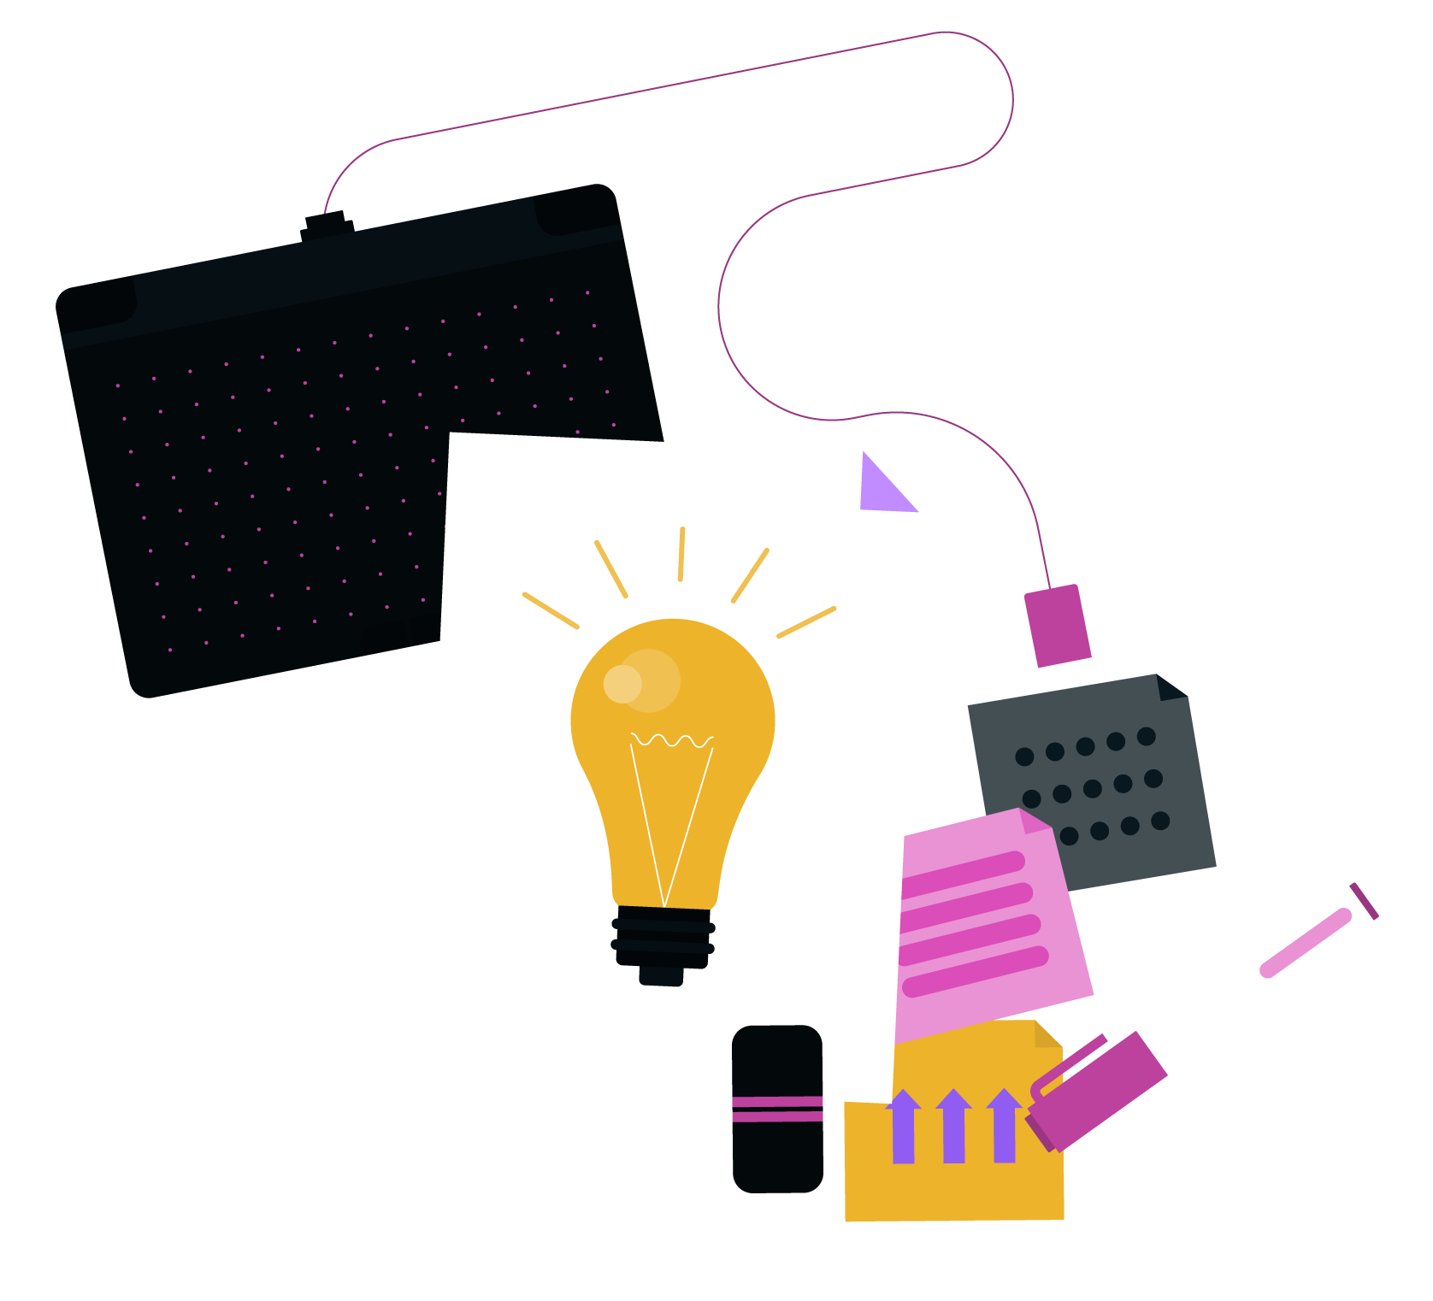
THANKS!

